Slide 1
Full Stack Web Development
CouchDB/ Getting Started

Slide 2
What Is CouchDB?
Apache CouchDB is open source database software that focuses on ease of use and having an architecture that "completely embraces the Web". ... Unlike a relational database, a CouchDB database does not store data and relationships in tables. Instead, each database is a collection of independent documents
Cross Platform: Linux / Unix / Windows / Mac / FreeBSD

Slide 3
Advantages of CouchDB
Easy replication of a database across multiple server instances
Fast indexing and retrieval
REST-like interface for document insertion, updates, retrieval and deletion
JSON-based document format (easily translatable across different languages)
Multiple libraries for your language of choice
Subscribable data updates on the _changes feed

Slide 4
Couch Replication Protocol
A protocol for synchronizing JSON documents between two peers over HTTP/1.1 by using the CouchDB REST API and is based on the CouchDB MVCC Data model
Replicates SOURCE -> TARGET
Retrieves basic info using GET /{db} requests
Must contain “instance_start_time” and “update_seq” fields

Slide 5
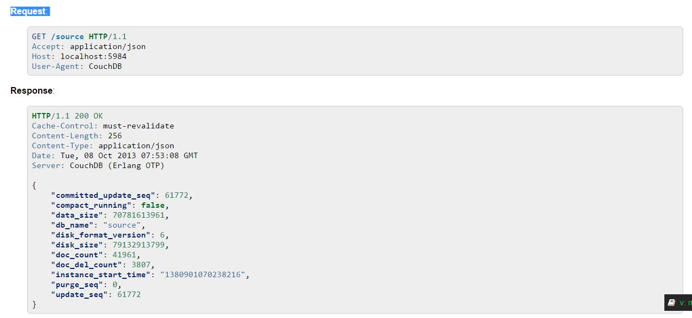
GET Source Information

Slide 6
Generate Replication ID
Before replication is started, the Replicator must generate an ID. This is used to track history, resume and continue previously interrupted replication process
CouchDB uses the following factors when generating an ID
Persistent Peer UUID value. For CouchDB, the local Server UUID is used
Source and Target URI and if Source or Target are local or remote Databases
If Target needed to be created
If Replication is Continuous
Any custom headers and OAuth headers if any
Filter function code if used

Slide 7
Setup Types
Single Node
Uses a single node
Most common setup
Works like any other database behind an application server of your choice
Does not take advantage of things like new scaling and fault tolerance
Cluster
Run a single logical DB on any number of servers or VMs
Much more advanced
Higher capacity and availability without changing APIs
Node management features

Slide 8
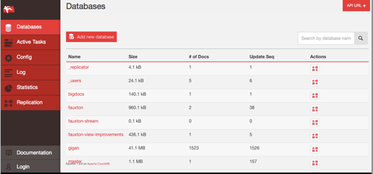
Fauxton
Fauxton is the Web UI for CouchDB. It can be installed via NPM as well as using the Windows CouchDB installer
Create & Manage Databases
Create & Manage Documents
View Logs & Stats
Manage Tasks
Create Views

Slide 9
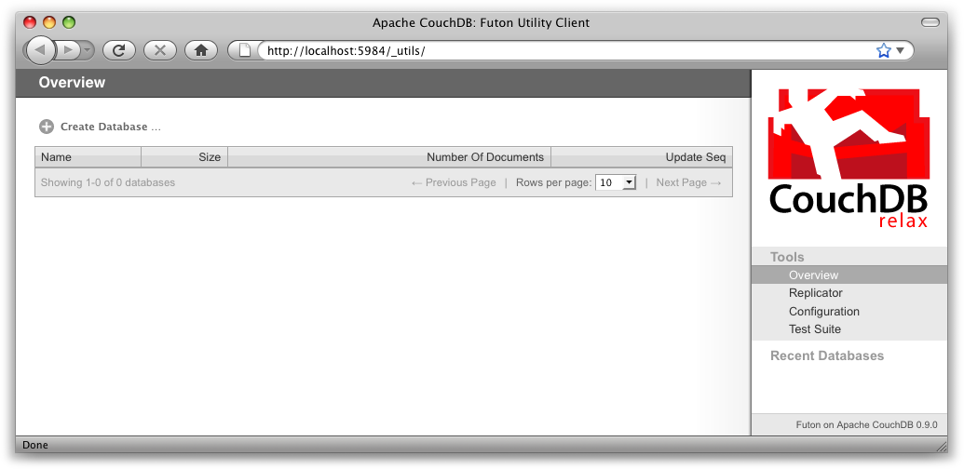
Futon
Futon is the Web UI for CouchDB. It can be installed via NPM as well as using the Windows CouchDB installer
Create & Manage Databases
Create & Manage Documents
View Logs & Stats
Manage Tasks
Create Views

Slide 10
Working With Views
Views are a way to filter or query the data in your database
Typically written using JavaScript although it is possible to use other languages
Each view maps keys->values inside a document
Views are tied to a designed document
function(doc) {
if (doc.docType == 'Event') {
emit(doc.id, doc);
}
}

Slide 11


